Slide 1

Toward phylodynamic inference from Typewriter lineage recordings
Antoine Zwaans & Sophie Seidel
03/04/2023
Sophie Seidel
30 June 2021, ISMB/ECCB
Notes:
Hello & thank you for joining
Present a framework to estimate
-> use single cell lineage tracing & rna seq data
→ to infer
1

Slide 2
Outline
Model validation
Runtime
HEK cell proof-of-concept analysis
Tree space considerations

Slide 3

Clock rate – editing speed

Slide 4
Insert probabilities – which insertion

Slide 5
Validation results
Clock rate (Cov=97%)
Insert probabilities (Cov=95%)

Slide 6
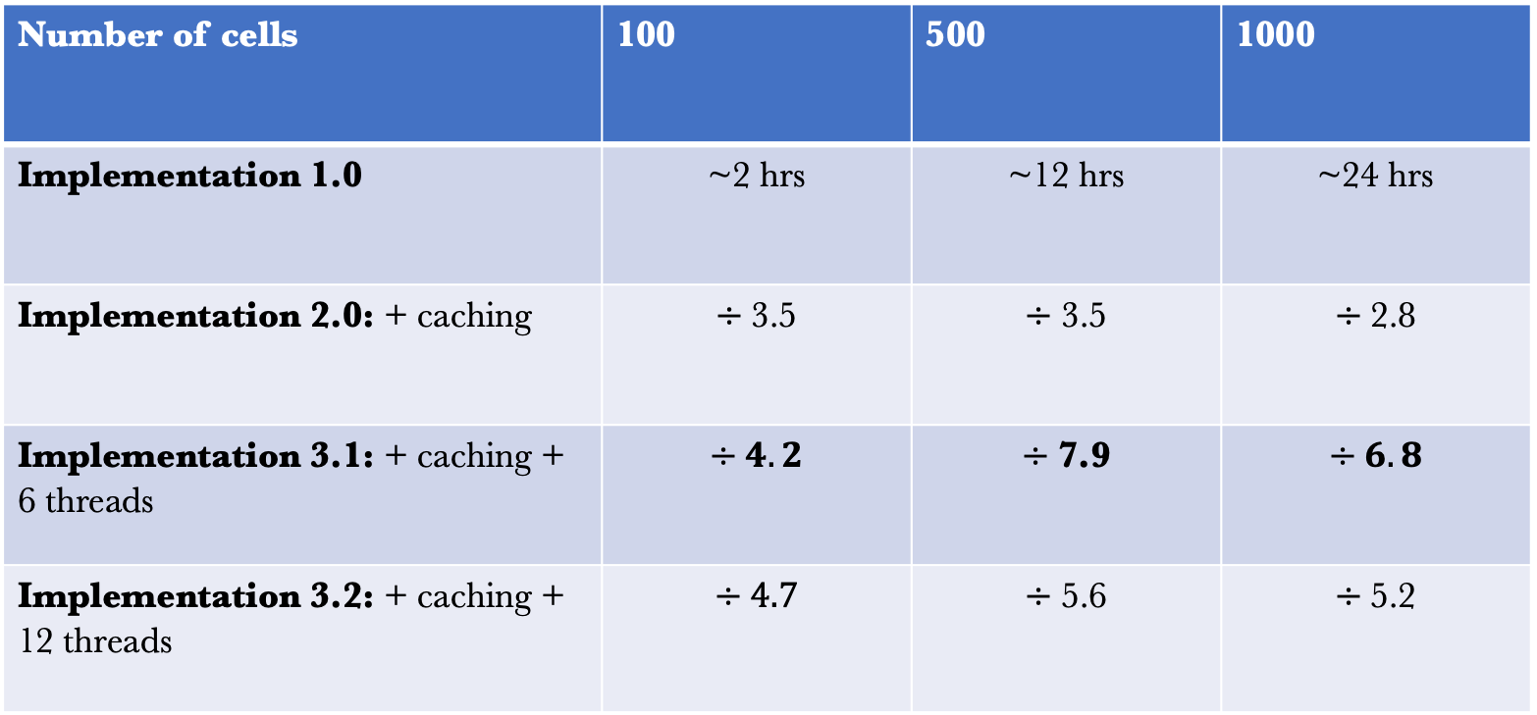
Runtime (10,000,000 iterations)
Number of cells | 100 | 500 | 1000
Implementation 1.0 | ~2 hrs | ~12 hrs | ~24 hrs
Implementation 2.0: + caching | $$÷\text{3.5}$$ | $$÷\text{3.5}$$ | $$÷\text{2.8}$$
Implementation 3.1: + caching + 6 threads | $$÷4.2$$ | $$÷\text{7.9}$$ | $$÷6.8$$
Implementation 3.2: + caching + 12 threads | $$÷4.7$$ | $$÷\text{5.6}$$ | $$÷\text{5.2}$$

Slide 7
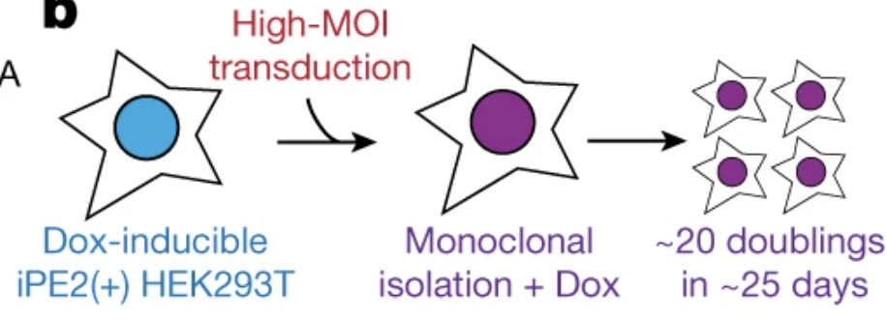
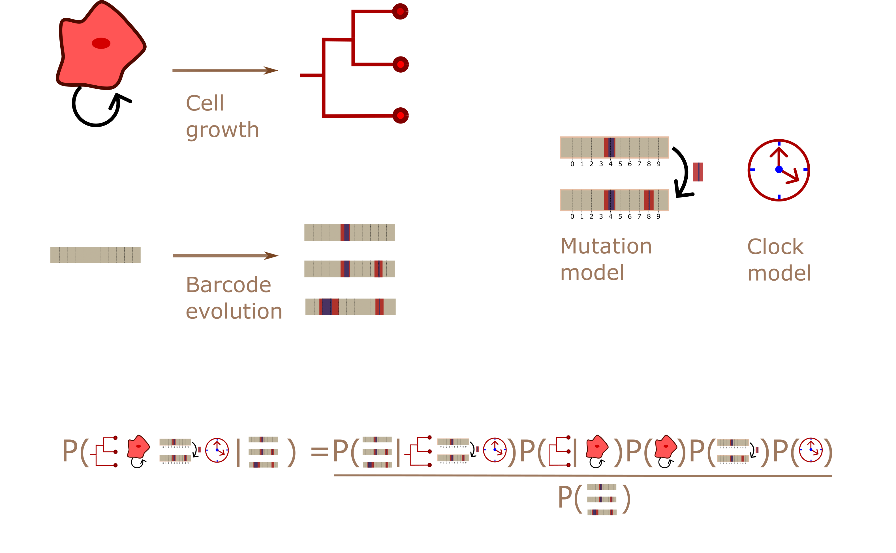
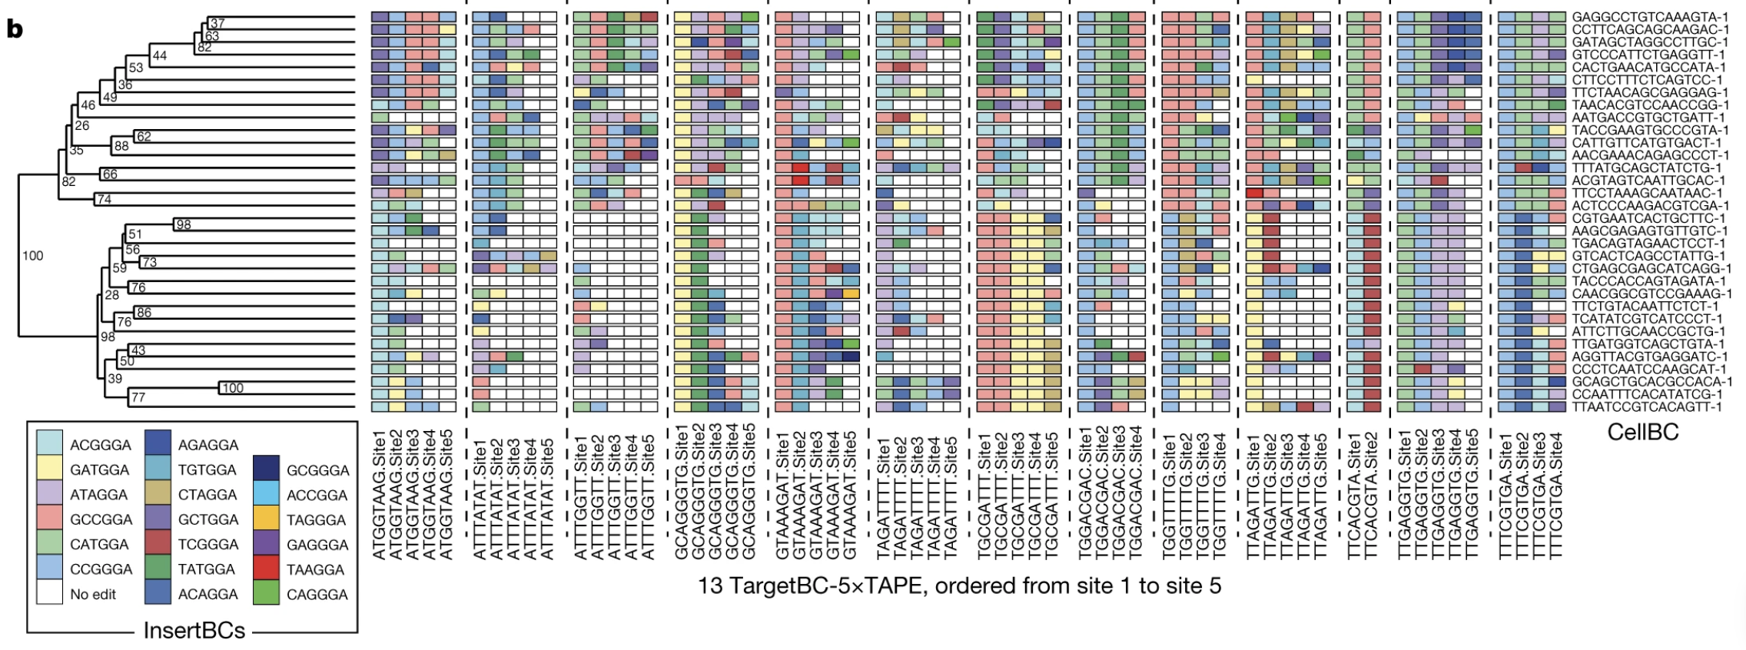
Analysis of the HEK data
Phylogenetic Bayesian inference framework

Slide 8
Analysis of the HEK data

Slide 9
Analysis of the HEK data

Slide 10
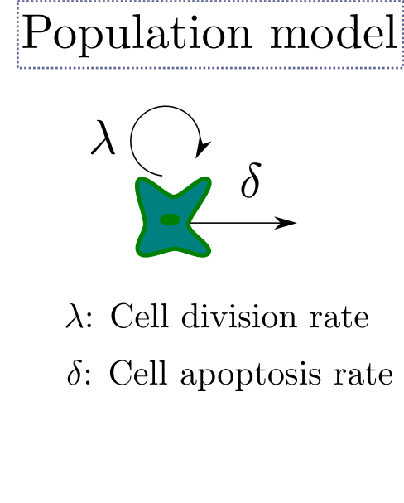
Analysis of the HEK data

Slide 11
Analysis of the HEK data

Slide 12
Thinking about tree space MAP vs UPGMA

Slide 13
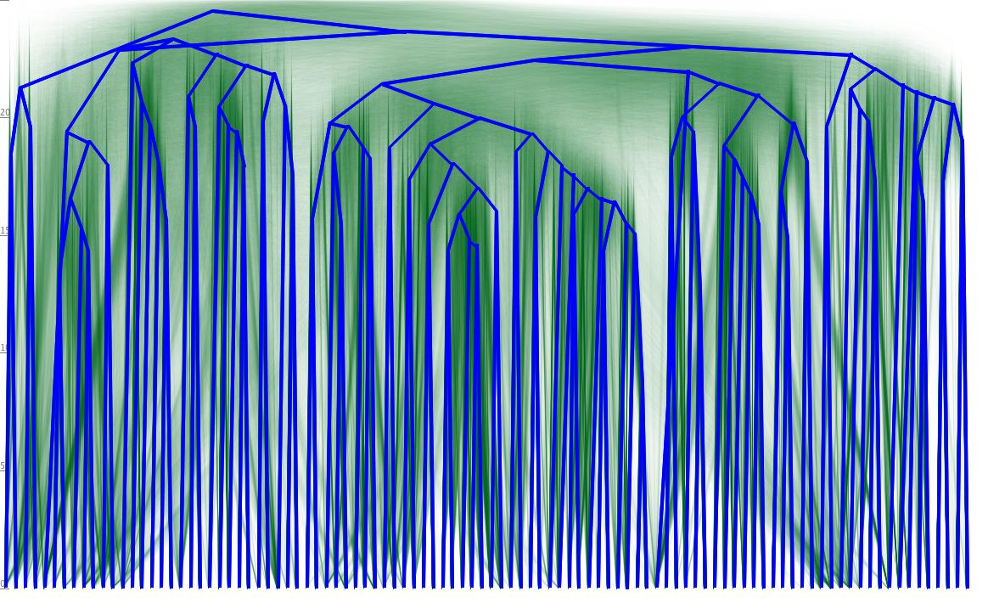
Thinking about tree space – Tree posterior

Slide 14
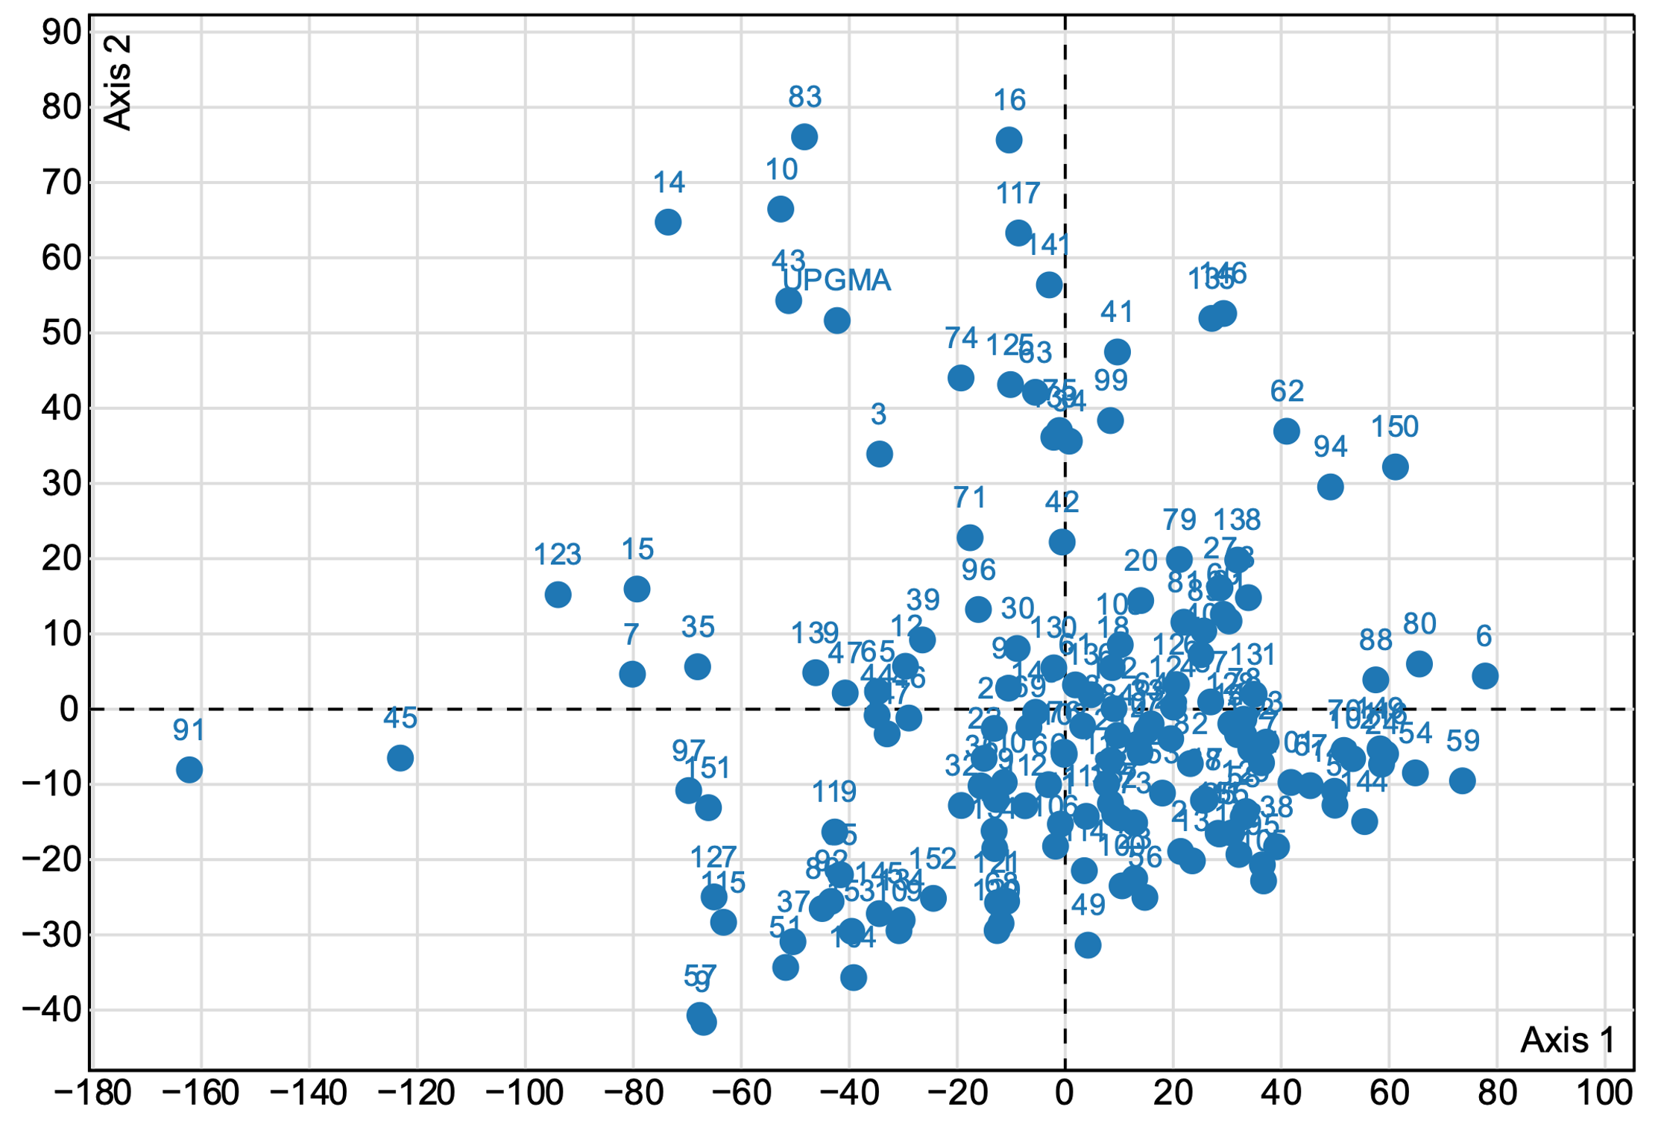
Thinking about tree space

Slide 15
Questions / Discussion
HEK cell proof-of-concept analysis + transcriptome?
Analysis with fixed tree topology
Analytical results: Dr. François Bienvenu

